Slide 1
Graduation practice #2
Tuesday, May 21, 2019

Slide 2
SEAT ASSIGNMENTS
Find your seat.
Can’t find your seat; ask for help.
Row letters are located on the far end chairs.

Slide 3
Welcome Class of 2019
During today’s practice we will :
address any questions
review program
practice processional/recessional
run through with names
review dress rehearsal day
distribute caps/gowns/tickets.

Slide 4
Observations from yesterday…
.
Girls in the front row…cross your legs at the ankle.
When you come in and are waiting for classmates to complete the processional…remain QUIET.
Rain…line-up under the pavilion.
Take care of bathroom issues before processional.
Remember that Grandma and Grandpa are here. Make them proud.
Remember teachers are on the row ends. They will move for you; be polite.
Process in with poise and grace.

Slide 5
Program Review
Processional
Choir to risers, speakers backstage, Bawi to podium #2
Bawi introduces National Anthem; Choir sings: Do NOT shout “O”.
Welcome: Kamryn
Stage Guest Introductions: Tori & Bawi
Performance: Choir & Chamber Singers
Speech #1: Katie
Performance: Zach & Simon
Speech #2: Amira
Performance: Jazz Combo
Speech #3: Joel
Calvin Ball
Dr. DiPaula
Superintendent – Dr. Martirano
Ms. Coombs (She is your cue to look over to Ms. Speirs.)
Ms. Pfanstiehl/Ms. Reid announces decorum expectations

Slide 6
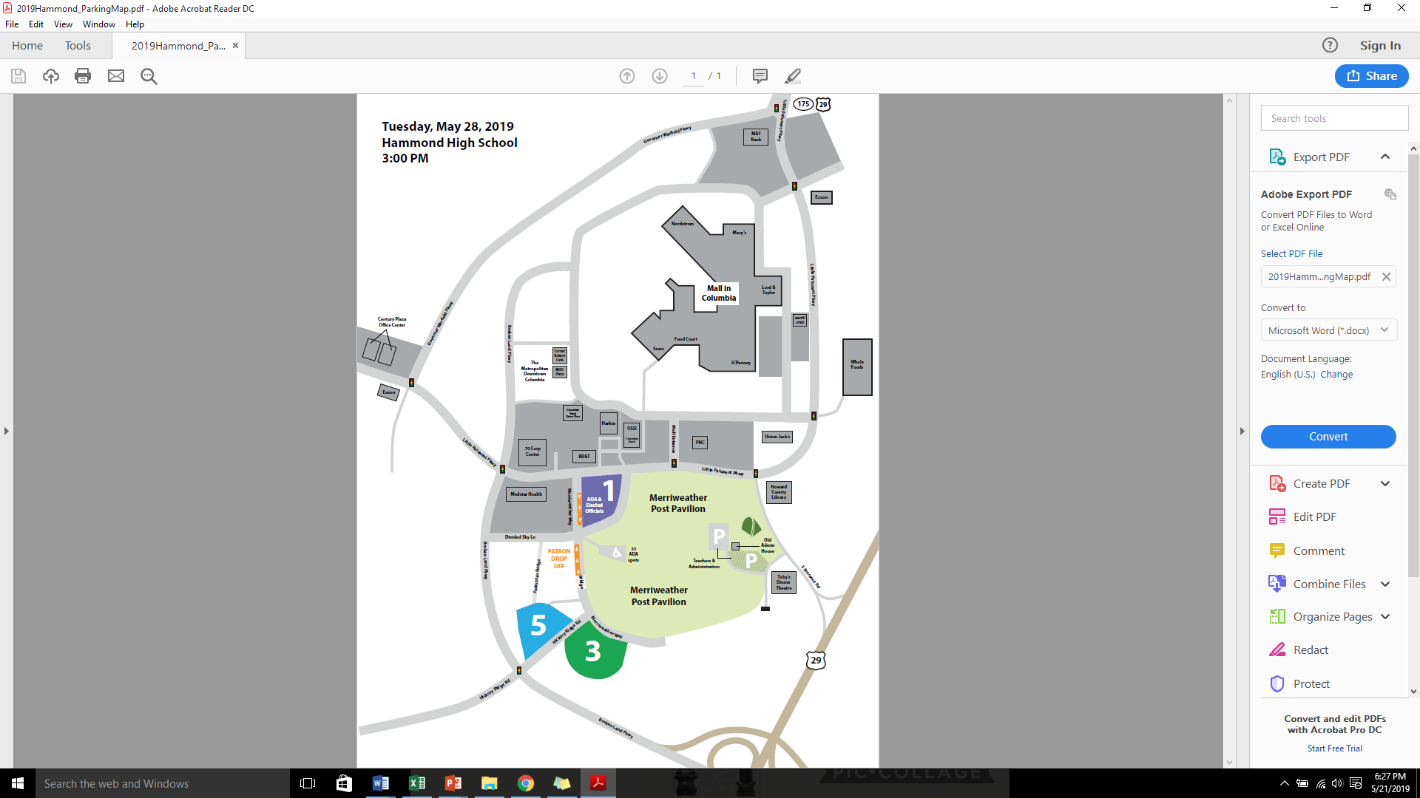
Parking At Merriweather

Slide 7
Parking
Booster VIP Parking Winners- please see Ms. Sibrian or Ms. Phillips before you leave today!
Cory Larsson
Taylor Liguori
Elizabeth MCMillan
Mathias O’Neill

Slide 8
At Merriweather look for…
Left (looking at stage)
Ms. Speirs
Ms. Filipiak
Ms. Niland
Right (looking at stage)
Ms. Tsavaris
Ms. Isch
Ms. Tobiason

Slide 9
Reminder…Processional
Keep the line moving/pace yourself. NO POSING for pictures, hugs etc. Maintain a formal tone.
Do NOT carry purses, cameras, phones, etc. Your hands are EMPTY. You will be line checked before walking onto the stage.
Teacher seats: They will move for you.
SMILE
No hands in pockets; stand up straight!

Slide 10
Name Reading
Do NOT avoid telling us the correct pronunciation of your name. We want to get it correct. This is your last chance to see Ms. Reid and Ms. Pfanstiehl.
You may NOT change your name. We have to read what is on your birth certificate.
We will teach you how to shake someone’s hand, get your diploma and pose for a picture simultaneously.
As you come down the steps from having your name read, you will receive your tickets…as long as you have NO OBLIGATIONS.

Slide 11
HaHs 2018
BACKSTAGE
FINAL CHECK
NAME CHECKER
NAME CHECKER
SIVELL
Backstage Area
NAME CHECKER
Diploma Covers
Person
David Aodu & Talib
Pierre
Person
PIANO
Backstage Area
Parents waiting to present diplomas
Anne Corey
Person
Person
Person
PHOTOGRAPHER
Lectern
MIC #1
Class Sponsor
Class Sponsor
Lectern
MIC #2
Pfansteihl
VIEW LOOKING AT STAGE FROM AUDIENCE
Mona Reid

Slide 12
Practice, practice
Tassel turner, Simi Liadi, will guide us through a recessional run through.
Once everyone is settled into hallway spots, we will begin a processional run through.
Bawi will guide us through National Anthem and then seat you.
The name game shall begin.

Slide 13
Practice, practice
When you come down the stairs, stop at Ms. Blossom’s table and pick up your tickets. NO EXTRAS!! Do not lose them.
As you head to your seat, you will meet with guidance to make sure the diplomas are in the right order.
As we progress through the lines, we will send you, one line at a time, to the back of the auditorium to pick up your cap/gown. Return to your seat directly after so that we can send the next row.

Slide 14
Seat Dwellers
This is when you will practice your skills in developing patience.
You may NOT get out of your seat or move to another location.
Opportunity to pay obligations.
“Thank you” to teacher… distribute.
Bear Press—senior edition
Cap/gown/ticket distribution

Slide 15
Let’s get in a practice!!

Slide 16
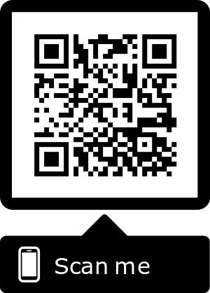
BORED? Try some of these!!
Senior Fair Feedback Link:
Fill Out a “Thank You” to a teacher
Read the Senior Newspaper
Crossword Puzzles

Slide 17
Dress Rehearsal
Tomorrow, meet us in the gymnasium at 8:25 A.M. We will begin the day with the panoramic picture. Bring your money and order form if you are ordering/purchasing a picture.
Dress Rehearsal—we have 35 minutes to go through entire ceremony. (9:15-9:50)
What to wear?? Wear your COSTUME. This is our opportunity to check your clothes, shoes, cap/gown etc.

Slide 18
Dress Rehearsal
Bring in an early dismissal note if you intend on leaving school after the awards ceremony.
You will have an opportunity to have a break in the cafeteria from 9:50-10:15. We will NOT be providing food, but feel free to pack a brunch snack for yourself.
We will line up in the hallway10:15-10:25.
The processional into the awards ceremony will begin promptly at 10:30.

Slide 19
Awards Ceremony
Front row, do NOT go back stage tomorrow during processional. Chorus go to the front to sing.
Once all seniors process in, continue to stand for the National Anthem.
Dr. DiPaula will signal you to remove your caps. Then he will seat you.
At end, Dr. DiPaula will say “Graduates, would you please stand?” Recess out. Do NOT stop outside of the auditorium. We will see you on Tuesday at 2:00 P.M. in your line. (Don’t forget early dismissal notes for tomorrow!)

Slide 20
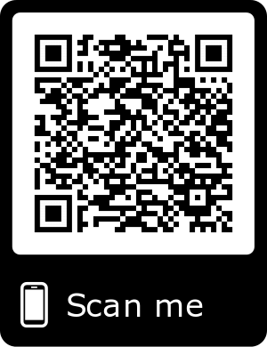
Quick Announcements
If you want to keep your materials on your Google Drive, you must download them to your personal account or to your computer. Your Howard County accounts will be eliminated at the end of June. You will need to do this on a computer where they can download files.

Slide 21
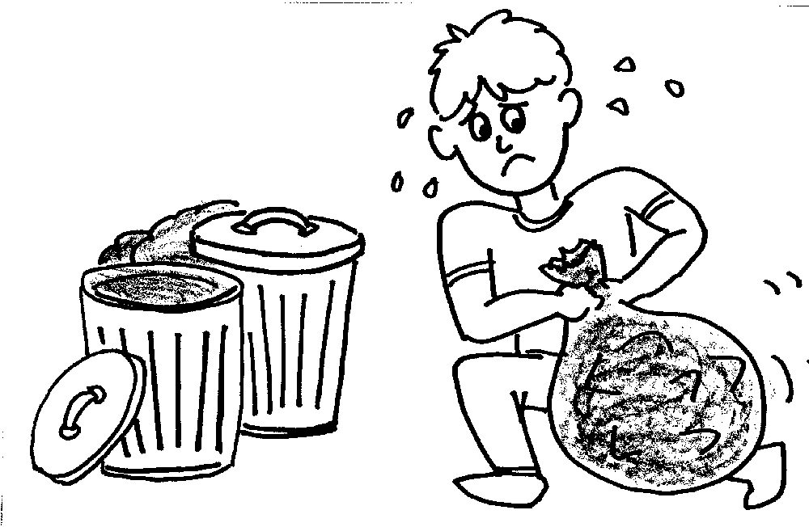
Trash
Look around your seat and take all trash with you!!

Slide 22
See you bright and early tomorrow!!

