Slide 1
Acceptable use of Technology/Social Media at HHS
Preparing students for College and Career Readiness through Rigorous Instructional Practices

Slide 2
Acceptable use of Technology/Social Media at HHS
Students will review HCPSS Responsible Use of Tech form during 1st period on Monday
Students must return form with parent signature to 1st period on Tuesday

Slide 3
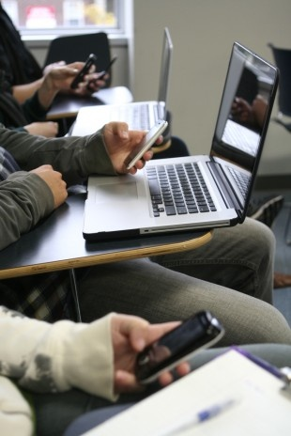
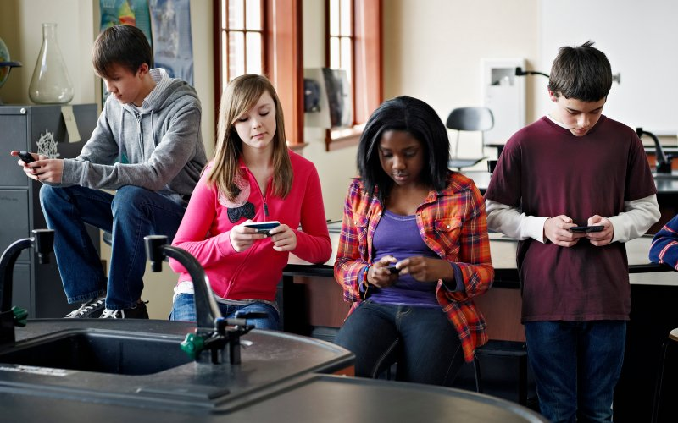
Acceptable use is NOT…

Slide 4
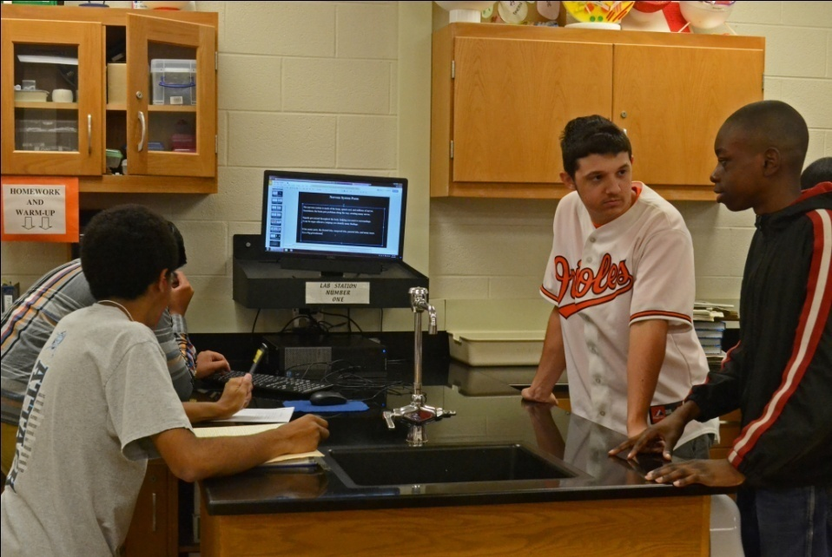
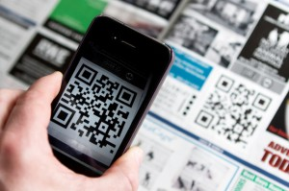
Acceptable use IS…

Slide 5
Acceptable use of Technology/Social Media at HHS
Think of the school as a professional setting
Abuse of technology/social media can cause short and long term hurdles
Does your student find themselves in an uncomfortable situation resulting from Social Media?
Schedule an appt with Mr. Kosisky the 9th gr. Counselor
All students have a right to the great instruction taking place at HHS without distraction

